Slide 1

healthcare provider fraud prediction
Liz Meyer
COSC 6330

Slide 2
problem
Health care fraud is the act of intentionally submitting fraudulent claims to health insurers to receive illegal benefits or payments (FBI, 2026)
Health care fraud costs the U.S. health care system $100 billion to $170 billion in losses each year and can lead to:
Increased insurance premiums
Higher taxes
Patient harm
Legal penalties for providers
Medicare provider fraud is a specific type of health care fraud where health care providers submit false claims to the Medicare program for reimbursement
Double billing (submitting multiple claims for the same service)
Phantom billing (submitting a claim for a service that never happened)
Upcoding (submitting a claim for a more expensive or complex service than the patient received)

Slide 3
Past Medicare fraud detection work
Bauder & Khoshgoftaar (2017) compared supervised, unsupervised, and hybrid ML approaches
Takeaway: Supervised methods outperformed unsupervised and hybrid methods
Johnson & Khoshgoftaar (2019) used different deep learning approaches to address the extreme class imbalance present in Medicare fraud prediction tasks
Takeaway: Oversampling techniques improved deep learning performance under severe class imbalance
Yoo et al. (2023) explored graph-based neural networks and evaluated relationships between insurance providers, patients, and physicians
Takeaway: Graph-based features enhanced fraud detection performance, with traditional ML using graph centrality outperforming graph neural networks

Slide 4
dataset
Healthcare Provider Fraud Detection Analysis (2019) dataset from Kaggle
Four main datasets
Inpatient
Claim data for patients who received services while admitted into a hospital
Diagnosis/procedure codes, reimbursement amounts ($), claim duration, admission and discharge dates
Outpatient
Claim data for patients who visited the hospital to receive a service but were not admitted
Similar to inpatient data
Beneficiary
Patient information
Race, gender, age, state, diagnosis/condition codes
Providers
Provider IDs with label of Fraudulent vs Not

Slide 5

Tools
Python
Jupyter Notebook
Kaggle
Libraries
Pandas
Numpy
Scikit-learn
XGBoost
Matplotlib/seaborn

Slide 6
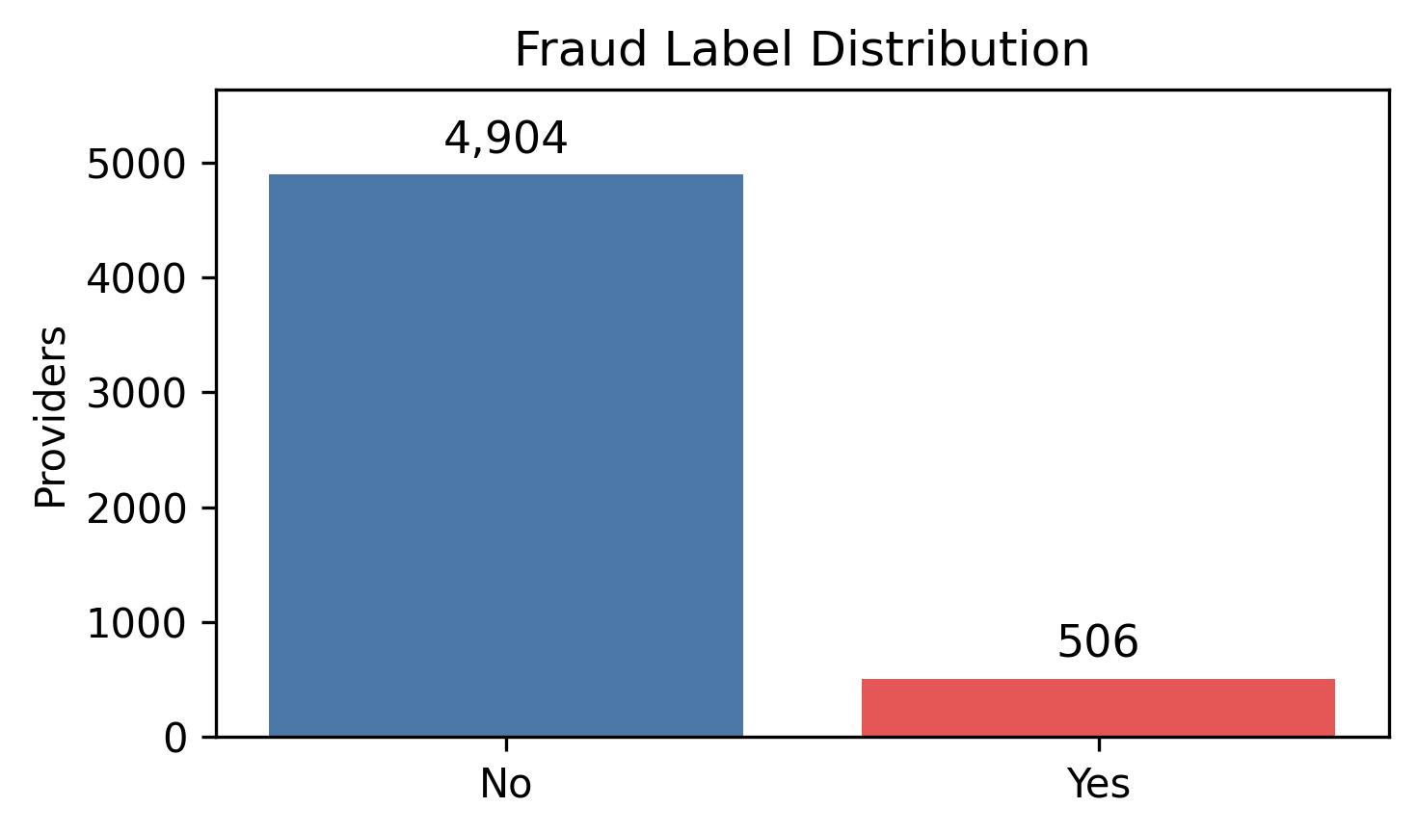
Exploratory data analysis
Datasets at a Glance
Statistic
Providers | 5,410
Beneficiaries | 138,556
Total Claims | 558,211
Providers w/ Fraud Label | 506
Only 9.35% of providers in the dataset are labeled as fraudulent --> class imbalance

Slide 7
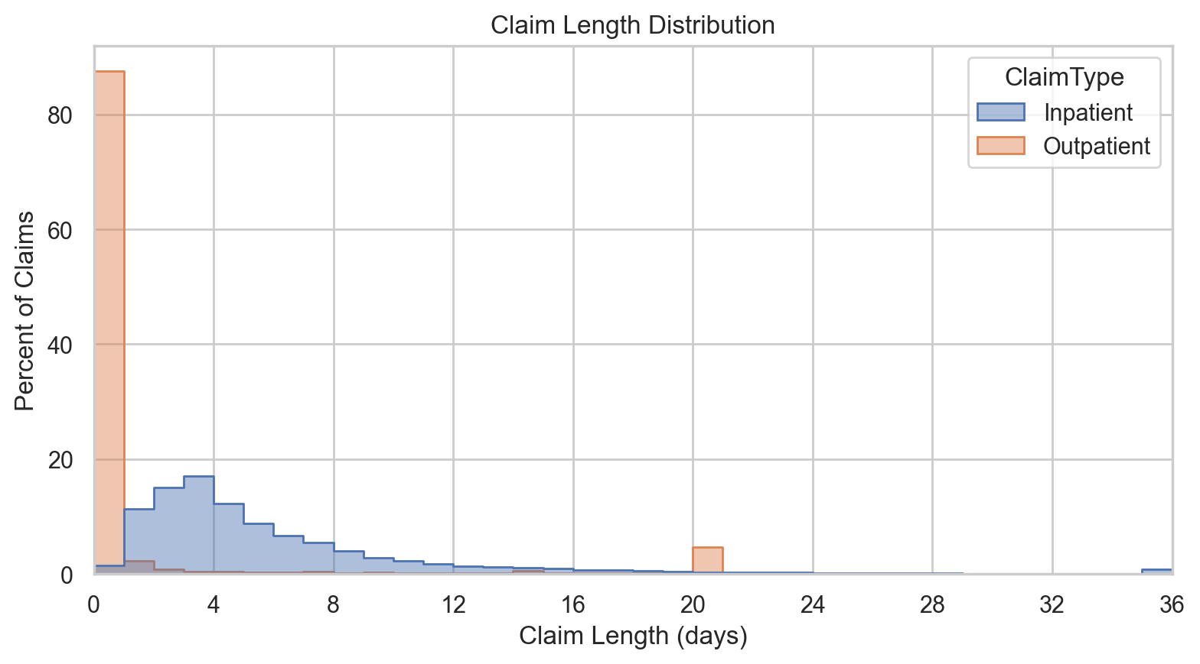
Exploratory data analysis
Claim Type | # of Claims | Avg. Reimbursement | Avg. Claim Length
Inpatient | 40,474 | $10,087.88 | 5.66 days
Outpatient | 517,737 | $286.33 | 1.42 days
Outpatient claims make up most records, but inpatient claims are much more expensive and take longer on average.

Slide 8
Feature selection
Feature Engineering
Data was aggregated at the provider level to construct features that capture billing behaviors and beneficiary characteristics
The provider-level summary features fell under four main groups: Claim Volume, Cost Patterns, Claim Complexity, and Patient Mix
20 final features were used as model inputs
Feature Group | Features Used
Claim Volume | Claim count
Cost Patterns | Average reimbursement amount SD reimbursement amount Average deductible amount
Claim Complexity | Average # of diagnoses Average claim length Share with admission diagnosis
Patient Mix | Average age Average # of chronic conditions Renal disease rate

Slide 9
APPROACH
Supervised Models
Logistic Regression (baseline)
Random Forest
Gradient boosting (XGBoost)
Unsupervised Model
Isolation Forest (anomaly detection)
Class imbalance was addressed using class weighting/model settings to account for the low number of fraud-labeled providers
Model performance was compared using evaluation metrics such as accuracy, precision, recall, F1 score, and ROC-AUC

Slide 10
Results
Validation Set Metrics (Training metrics in paper)
Approach | Accuracy | Precision | Recall | F1 Score | ROC AUC
Logistic Regression (threshold: 0.7) | 0.92 | Non-Fraud: 0.98 Fraud: 0.54 | Non-Fraud: 0.93 Fraud: 0.79 | Non-Fraud: 0.95 Fraud: 0.64 | 0.95
Random Forest | 0.94 | Non-Fraud: 0.96 Fraud: 0.71 | Non-Fraud: 0.97 Fraud: 0.61 | Non-Fraud: 0.97 Fraud: 0.66 | 0.95
XGBoost | 0.92 | Non-Fraud: 0.98 Fraud: 0.55 | Non-Fraud: 0.94 Fraud: 0.77 | Non-Fraud: 0.96 Fraud: 0.64 | 0.95
Isolation Forest | 0.83 | Non-Fraud: 0.93 Fraud: 0.22 | Non-Fraud: 0.89 Fraud: 0.32 | Non-Fraud: 0.91 Fraud: 0.26 | 0.81

Slide 11
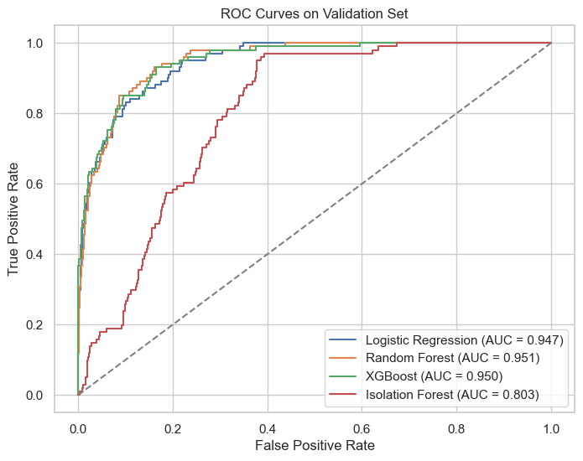
Results
Feature Importance for Random Forest + XGBoost
Feature | Random Forest | XGBoost
Inpatient Claim Ct | 0.15 | 0.21
SD Claim Reimbursement Amt | 0.11 | 0.16
Outpatient Claim Ct | 0.10 | 0.10
Mean Claim Length | 0.09 | 0.07
Mean Claim Reimbursement Amt | 0.09 | 0.05

Slide 12
Project outcome
Takeaways
Provider-level claim patterns can meaningfully predict potential Medicare fraud
Random Forest was the strongest overall model, balancing accuracy, precision, recall and ROC AUC
Logistic Regression and XGBoost caught more fraudulent providers, but created more false positives
Supervised learning methods substantially outperformed Isolation Forest, an unsupervised approach
This connects back to Bauder & Khoshgoftaar (2017)’s research, who found that supervised methods consistently outperformed unsupervised and hybrid ML approaches
The best model choice depends on your priorities – do you want to maximize fraud detection or minimize false alarms?

Slide 13
References
Bauder, R. A., & Khoshgoftaar, T. M. (2017). Medicare fraud detection using machine learning methods. In Proceedings of the 16th IEEE International Conference on Machine Learning and Applications (ICMLA) (pp. 858–865). https://doi.org/10.1109/ICMLA.2017.00-48
Federal Bureau of Investigation (FBI). Health Care Fraud. (2026). https://www.fbi.gov/investigate/white-collar-crime/health-care-fraud
Gupta, R. A. (2019, May 9). Healthcare Provider Fraud Detection Analysis. Kaggle. https://www.kaggle.com/datasets/rohitrox/healthcare-provider-fraud-detection-analysis
Johnson, J. M., & Khoshgoftaar, T. M. (2019). Medicare fraud detection using neural networks. Journal of Big Data, 6(1), 63. https://doi.org/10.1186/s40537-019-0225-0
Yoo, Y., Shin, J., & Kyeong, S. (2023). Medicare fraud detection using graph analysis: A comparative study of machine learning and graph neural networks. IEEE Access, 11, 88278–88294. https://doi.org/10.1109/ACCESS.2023.3305962

